Slide 1
Writing Introduction and Conclusion
By-Shivam Khant
CE-2 A Batch
Enroll.no.-86

Slide 2
Introduction
An introduction is a beginning section which states the purpose and goals of the following writing.
The introduction typically describes the scope of the document and gives a brief explanation the document. The readers can have an idea about the following text before they actually start reading it.

Slide 3
Why it is important?
The First impression is very important.
Without a good introduction , the rest of your paper will suffer because you have failed to capture your readers interest
The start of introduction should grab the reader’s attention. We never get another first impression.

Slide 4
Attention Getters
Problem: Pose a problem in the introduction and solve it in the body.
Statistics: Make sure they’re actual statics and not something you made up.
Comparison: Take something that reader is unfamiliar with and relate it to something they are familiar with it.
Expert Opinion: An expert gives you an instant credibility.

Slide 5
Example
Global climate change is a crisis that affects everyone, rich and poor, young and old. From rising ocean levels to increased temperature extremes, the world is changing for everyone. How will your life be different in the coming years?

Slide 6
Conclusion
A conclusion is the final piece of writing in a research paper, essay, or article that summarizes the entire work. The conclusion paragraph should restate your thesis, summarize the key supporting ideas you discussed throughout the work, and offer your final impression on the central idea.

Slide 7
Why it is important?
The purpose of a conclusion paragraph is to wrap up your writing and reinforce the main idea that you presented in the body of your paper.
A conclusion ties in the initial thesis statement presented in the opening paragraph along with supporting points and a final impression that gives the reader closure.
A well-written conclusion clearly relays the writer’s take-home message.

Slide 8
Conclusion Guidelines
1. Include a topic sentence: Conclusions should always begin with a topic sentence.
2. Use your introductory paragraph as a guide. When writing your conclusion, keep a copy of your introductory paragraph on hand as a reference.
3. Summarize the main ideas. Effective conclusions will restate the most relevant information to sum up the main point of the paper.

Slide 9
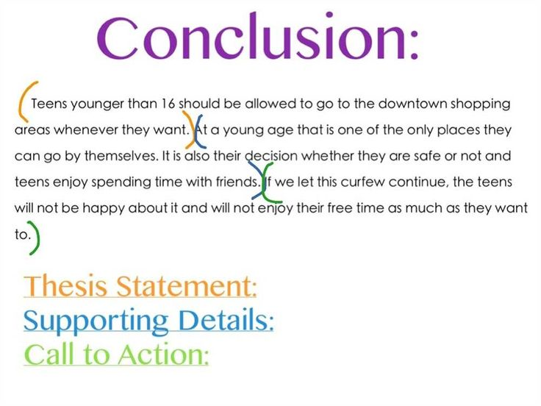
Example

Slide 10


